Slide 1

Maze Runner Game In Java
Using Eclipse IDE (for Android)

Slide 2
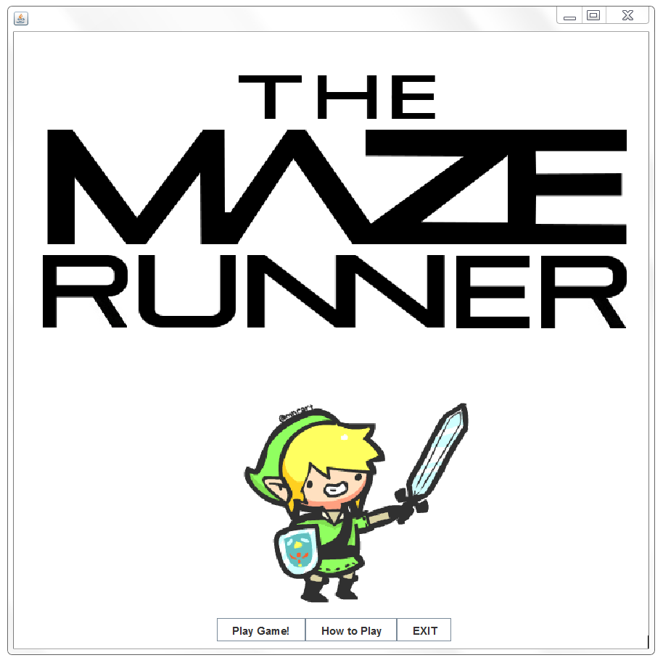
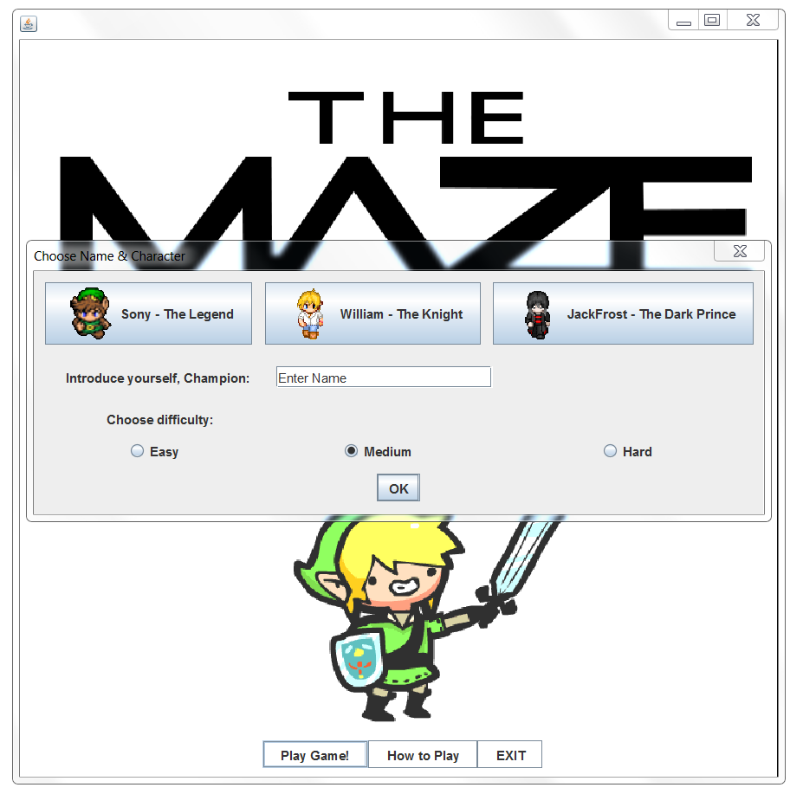

Slide 3
The Maze Runner is a simple 2D java game developed using the Eclipse IDE. This is a simple yet very interesting game developed in java programming language. More-over, this game enables your coding ability on writing the 2D sample games and how to handle the data structures so well. This java game involves solving a maze while collecting coins and avoiding enemy monsters. Players can progress through levels of increasingly difficulty up to level 10.
Levels are completed by picking up a golden key and unlocking a wooden door which appears in the bottom right corner of the screen.
There are also power ups such a 'sword' which can be used to kill enemies and 'freeze' which freezes all enemy movement. Enemies move towards the player each second and the number of enemies increase each level.
Players can also press a hint button to be presented with a path that guides them towards the wooden door.

Slide 4
1. Scope of the Project
Justification:
In support of the Eclipse IDE, the maze runner game has simplified and developed through Eclipse IDE, Java SDK and HTML. To this end, I worked sincerely to complete The Maze Runner Game.
Description:
The game has the following features :
Maze - The mazes are used to looks like a room in the house. And it uses some controls like maze runner in the game he runs through the way.
Tiles - Tiles are used in the game as intermission to the runner.
Hero - Hero rules are to collect the coins and kill the enemies and runs to the destination.
Enemies - They are intruders to the runner the main hero's. They interfere and kills the hero.
Key - The runner must find the key before enemy attacks. Without key runner can't escape from the maze.
Sword - The runner must find the sword to defend himself from enemy.
Coin - The coins are useful to power up the runner game points.
Hint - The runner can use hint from the player to reach the door.
Door - The runner after finding the key should reach the door to enter the next level.

Slide 5
2. SYSTEM REQUIREMENTS
Hardware and Software Requirements :
About development platform : Eclipse is the development platform of Objects Java. It is a cross-platform Java development environment.
System Requirements : The secondary development based on Objects Java can use Eclipse IDE 3.2 for Java Developers or higher version, the system requirements are as follows:
Windows System Minimum Hardware Requirements:
CPU: 2.00GHz single core processor
RAM: 512 MB
Free disk space: 10 GB
Video card: 128 MB
Windows System Recommended Hardware Requirements:
CPU: 3.00 GHz single core processor/2.00 GHz dual core processor
RAM: 2GB
Free disk space: 80 GB
Video card: Discrete graphics with 256MB video memory
Operating Systems:
Microsoft Windows Vista Series
Microsoft Windows Server 2008 Series
Microsoft Windows 7 Series

Slide 6
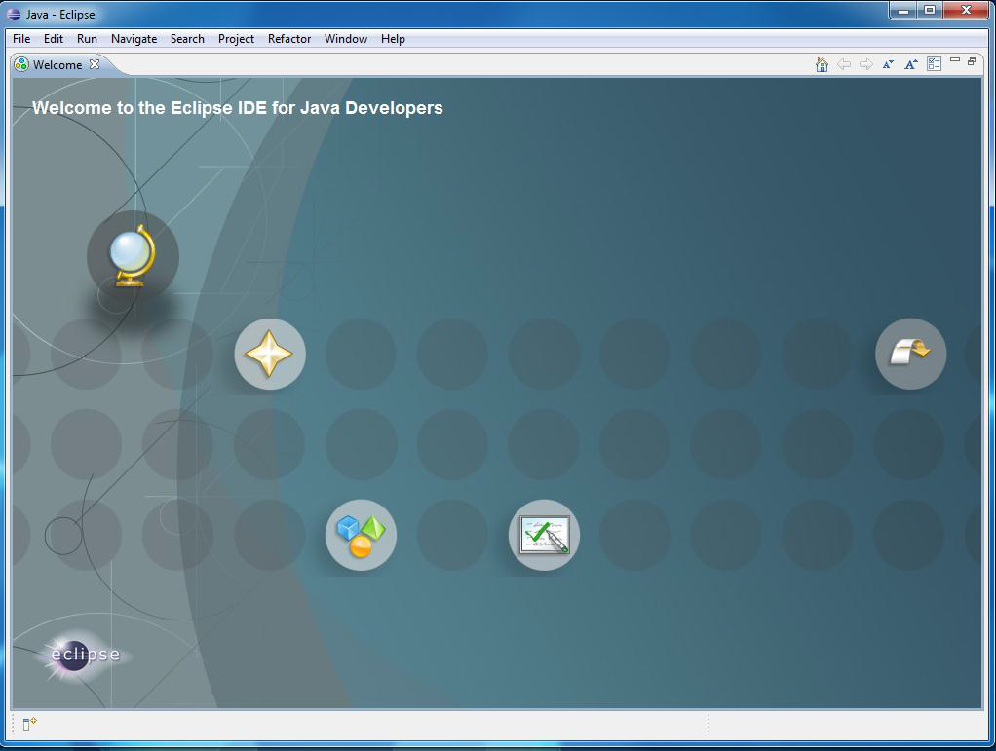
3. Installation and Configuration
3.1. Download and Configure Eclipse IDE
Eclipse is the preferred development environment for Android. You can download eclipse at http://www.eclipse.org/downloads/. It is recommended that you install either classic or the Java Version of eclipse.
Home screen of Eclipse for Java Developers

Slide 7
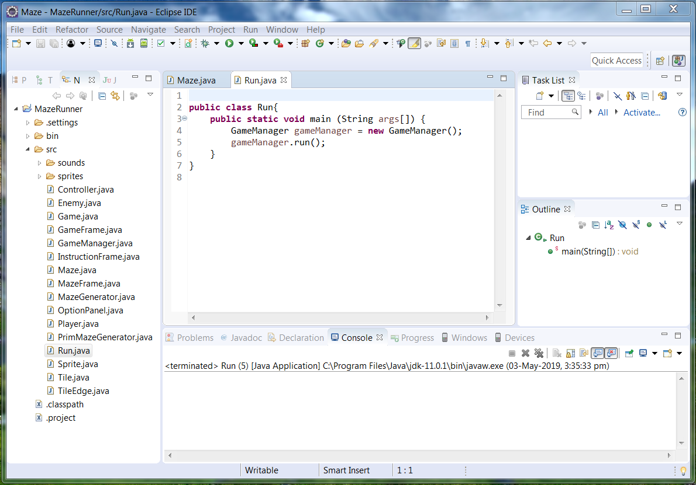
Figure: Screen after project creation.

Slide 8
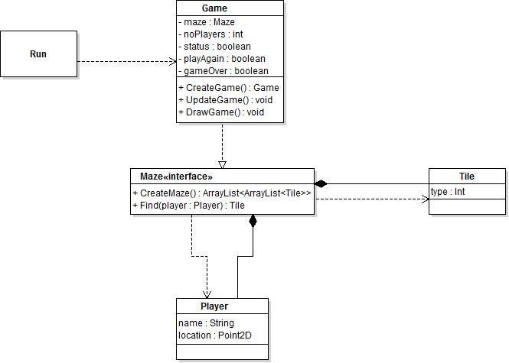
4. E-R Diagrams :
In this the E-R Diagram is implemented by using Run application and the Maze interface and Game and Tile and Player concept that can be used to run the game in real time system environment. In this way the code is written by using java in eclipse ide.

Slide 9
UML Diagrams :
In this I implemented the game frame and players that can easily play the game such as picking up coins, killing enemy and special thing is with sound effects will give some energy to the player.
This uml diagram show how to implement the game such as giving some rules to the project.
Some interfaces, classes were done by using some useful modules implemented by using java in eclipse ide.

Slide 10
Methods of Implementation :
There are some implemented methods that are very useful for the project game. Like...
1.Tile
2.Maze
3.PrimMazeGenerator
4.MazeGenerator(interface)
5.Game
6.Controller
7.MazeFrame
8.GameManager
9.InstructionFrame
10.GameFrame
11.OptionPanel(JPanel)
12.Player
13.Enemy
14.TileEdge
Like this I implemented such classes in java using eclipse ide.

Slide 11
5. Coding :
The coding of game is in java programming language. It is very simple and efficient to learn from beginning in programming. This is very powerful language in programming. The code have some prim maze generator, player, run, enemy and so on., to be created. For example :
Run.java :
public class Run{
public static void main (String args[]) {
GameManager gameManager = new GameManager();
gameManager.run();
}
}

Slide 12
Sprite.java :
import java.awt.*;
import javax.swing.ImageIcon;
public class Sprite {
private ImageIcon sprite;
public Sprite(String imageName, int x, int y) {
try {
sprite = new ImageIcon(this.getClass().getResource("/sprites/" + imageName + ".gif"));
Image image = sprite.getImage().getScaledInstance(x, y, Image.SCALE_FAST);
sprite.setImage(image);
} catch (Exception e) {}
}
public ImageIcon getSprite()
{
return this.sprite;
}
}

Slide 13
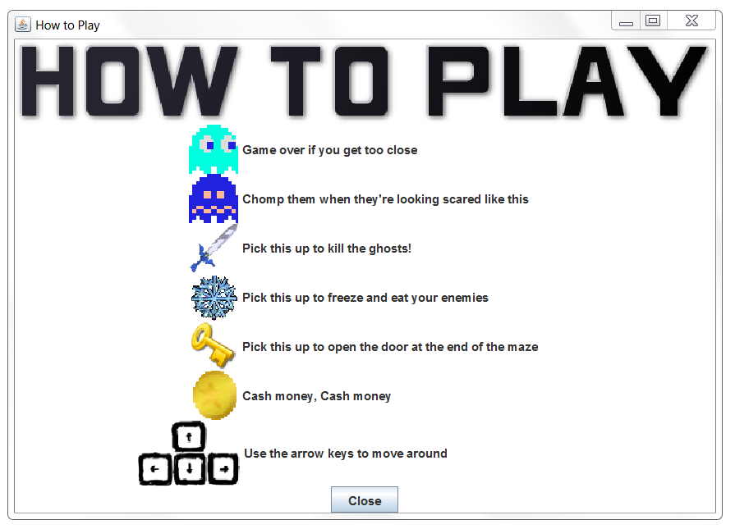
6. Output :
In this game I will create the modules as Continue the last game, Start New Game, High Score, Settings of the game, Save the game, Load the game again, and Exit from the game.

Slide 14
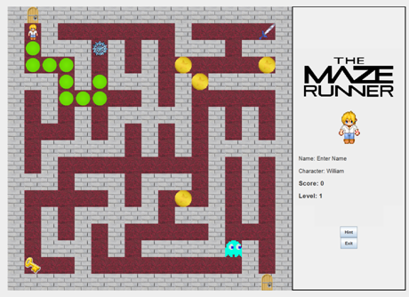

Final project output of the game in eclipse.

Slide 15


